Slide 1
Kaggle House Price Challenge
Team Least Squares

Slide 2
Workflow
Insert Diagram

Slide 3
Machine Learning Models
Insert diagram
Linear Regression Based
  Multi-Linear
  Ridge Regression
  Lasso Regression

Slide 4
EDA

Slide 5
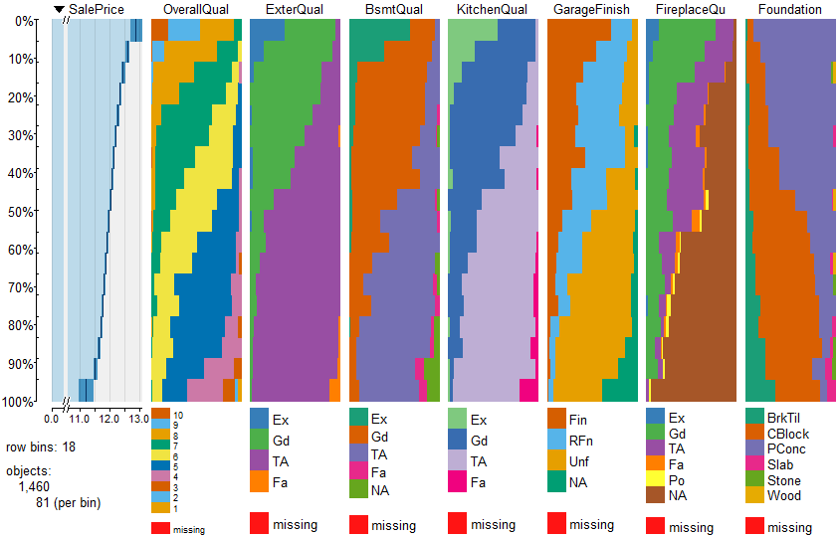
EDA - Categorical Vars

Slide 6
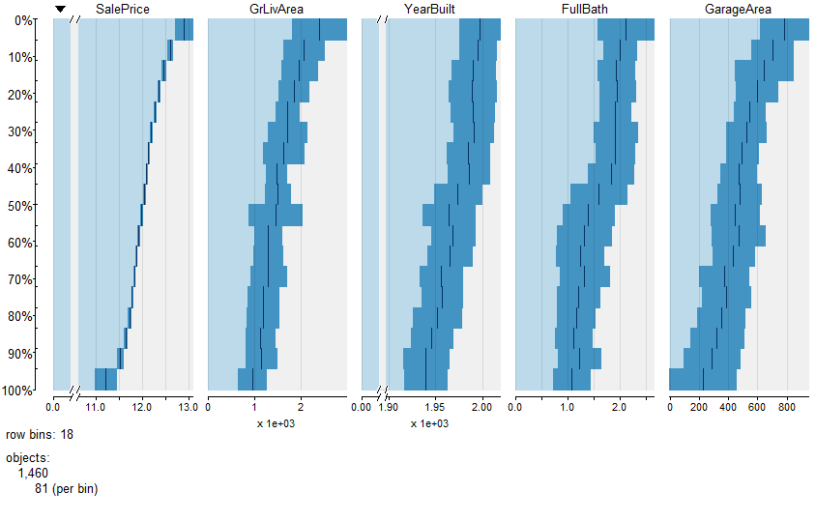
EDA - Continuous Vars

Slide 7
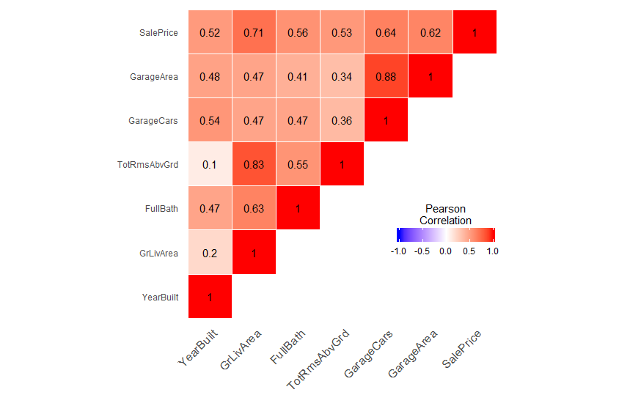
EDA – Correlation Plots

Slide 8
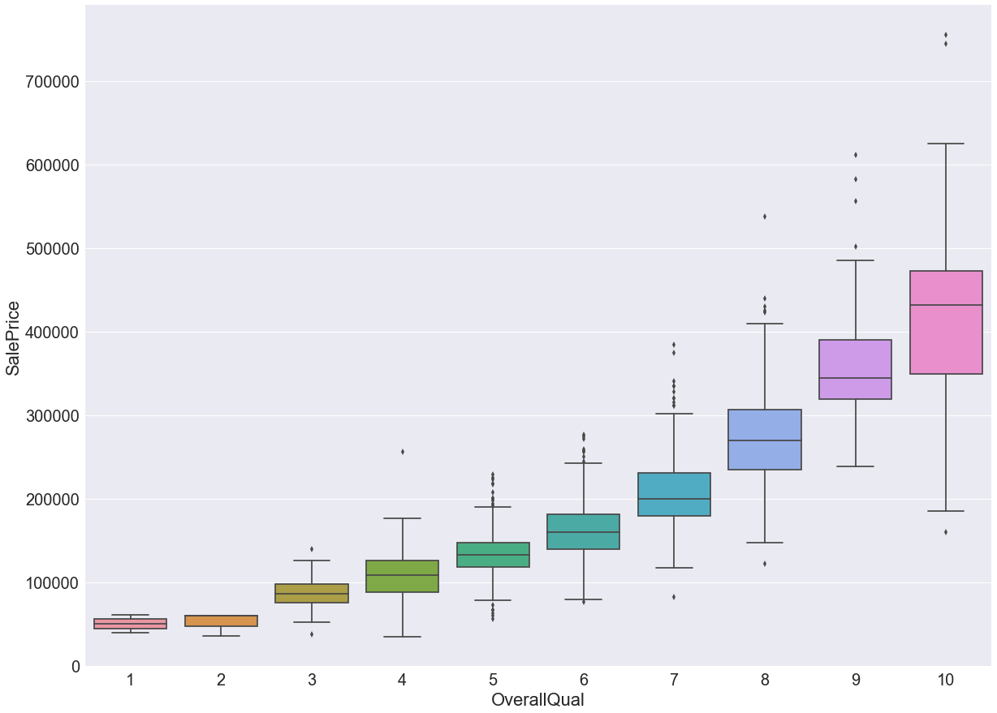
EDA - OverallQual

Slide 9
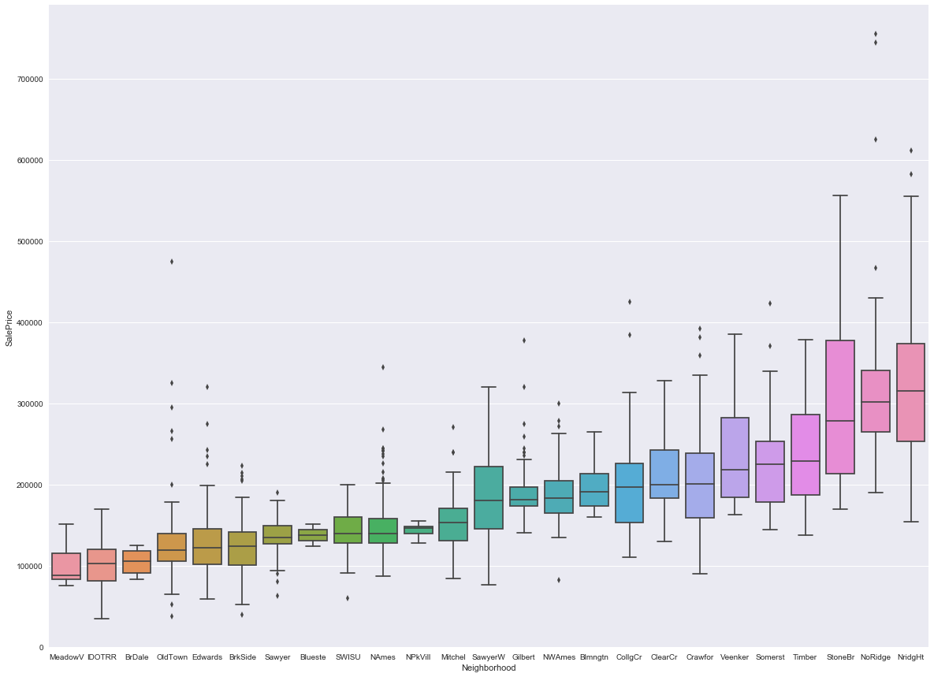
EDA - Neighborhood

Slide 10
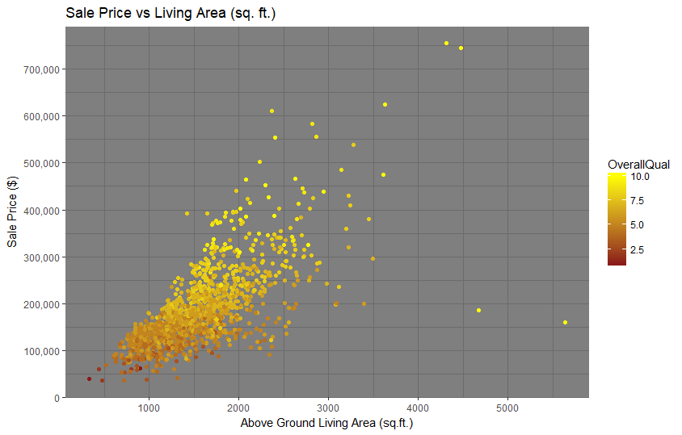
EDA - Scatterplot

Slide 11
Missingness
Categorical
  Impute 'None'
  Mode : Electrical
Continuous
  Mean
  Median

Slide 12
Feature Engineering
Outliers
Skewness
Scaled
Numerical=>Categorical

Slide 13
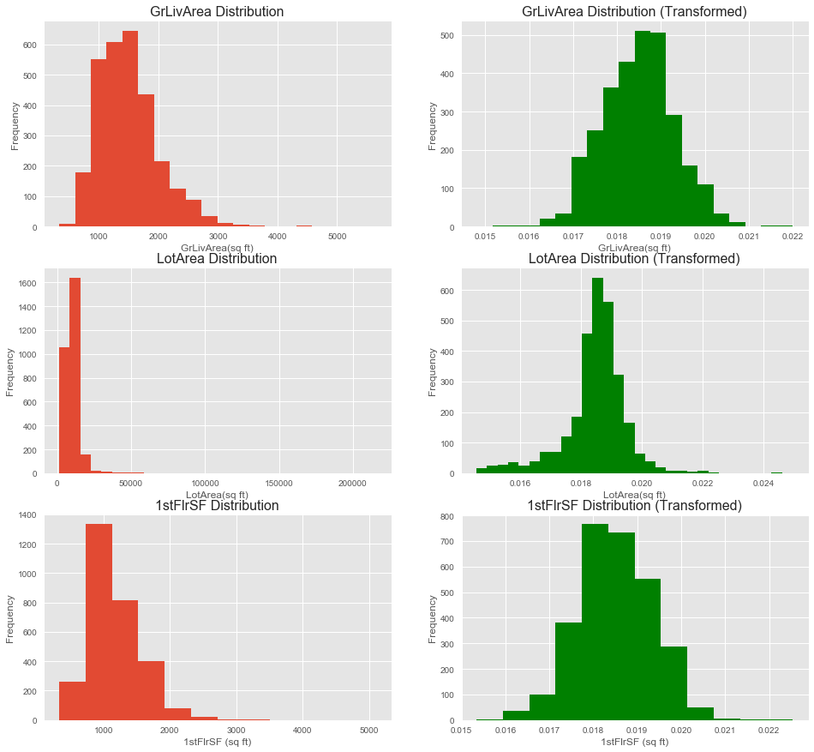
Feature Scaling & Skewness

Slide 14
Linear Models
Multiple Linear Regression
  Explored Initial shortlist of 20 Features
  Narrowed list to 5 features
  Performed Regression
Ridge/Lasso
  Explored Interaction of Features
  Expanded Shortlist with Interaction Features

Slide 15
Multiple Linear Regression
Shortlist of 20 Features
(Red ones used in Initial Regression)
Location | Style | Condition | Size | Other
Neighborhood | HouseStyle | OverallQual | GrLivArea | SaleCondition
MSZoning | Foundation | OverallCond | 1stFlrSF, 2ndFlrSF | SaleType
 | GarageFinish | YrBuilt | FullBath
 | Paved Drive | ExterQual | TotRms
 |  | BsmtQual | GarageCars
 |  |  | GarageArea

Slide 16
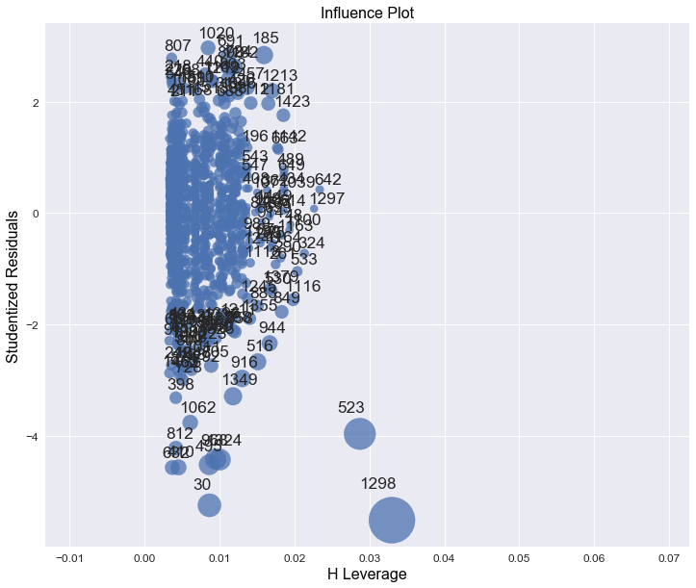
Multiple Linear Regression

Slide 17
Multiple Linear Regression
 | R^2 (Training Set) | RMSE (Training Set)
With Influential Points | 0.800 | 0.178
Without Influential Points | 0.807 | 0.176

Slide 18
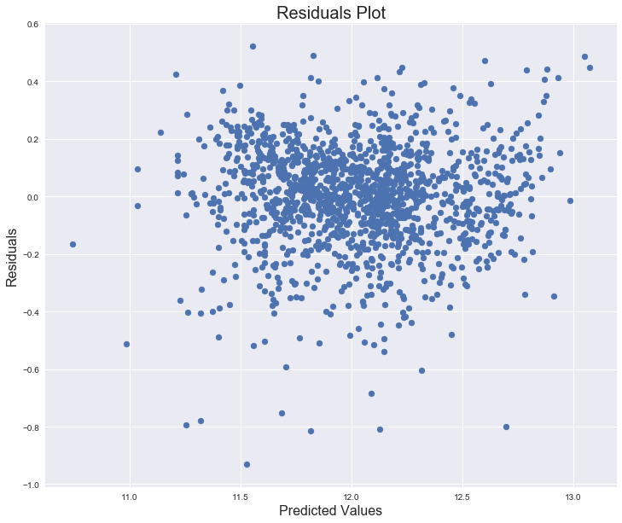
Multiple Linear Regression

Slide 19
Features Interactions

Slide 20
RIDGE/LASSO PROCESS
Split training data 80%/20%
Used grid search to tune hyperparameter
  5-fold cross-validation for each parameter value
Tested against remaining 20%
Trained against entire 100% of training set

Slide 21
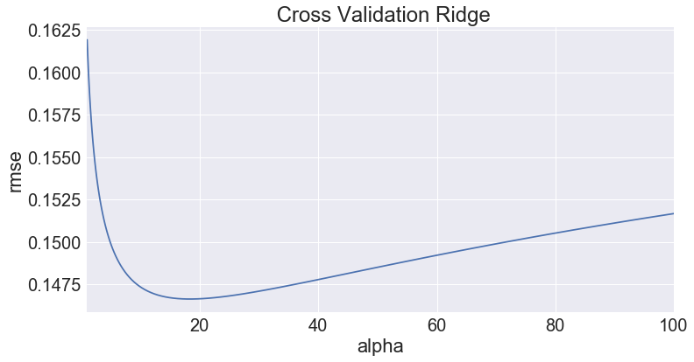
Ridge Regression
Best Alpha = 18.7

Slide 22
Ridge Regression
 | R^2 | RMSE
SUB-TRAINING SET (80%) | 0.938 | 0.100
TEST SET (20% | 0.913 | 0.111
TOTAL TRAINING SET (100%) | 0.933 | 0.099

Slide 23
Ridge Regression
Top Features | Coefficient Value
OverallCond_3
Neighborhood+OverallQual+

Slide 24
Ridge Regression
INSERT RESIDUALS PLOT?

Slide 25
Lasso Regression
 | R^2 (Training Set) | RMSE (Training Set)
SUB-TRAINING SET
TEST SET
TOTAL TRAINING SET

Slide 26
Lasso Regression
Top Features | Coefficient Value

Slide 27
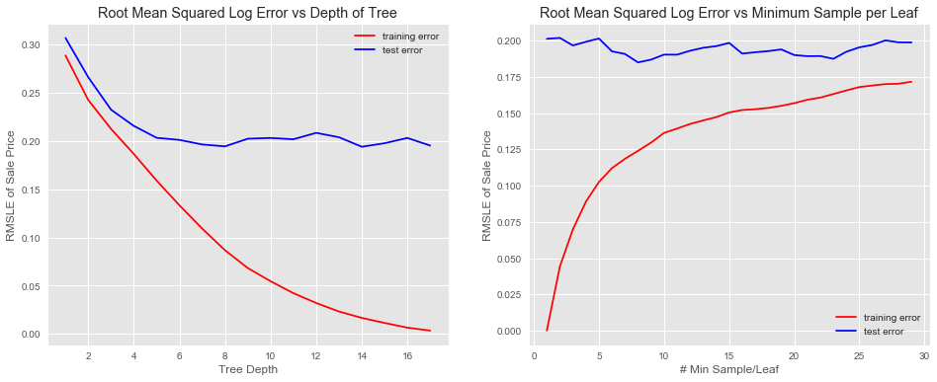
Decision Trees

Slide 28
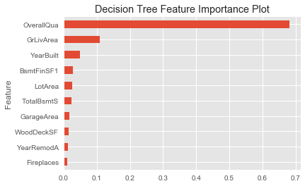
Decision Trees

Slide 29
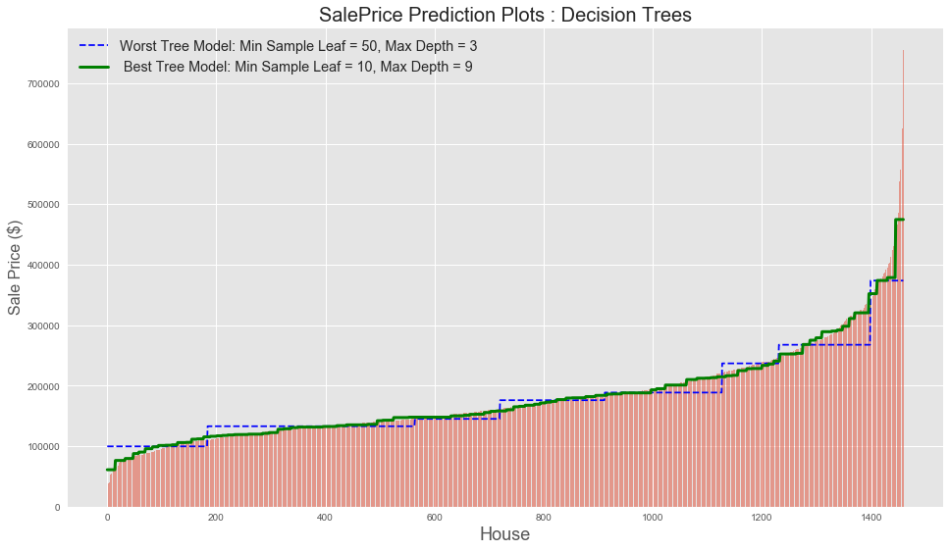
Decision Trees

Slide 30
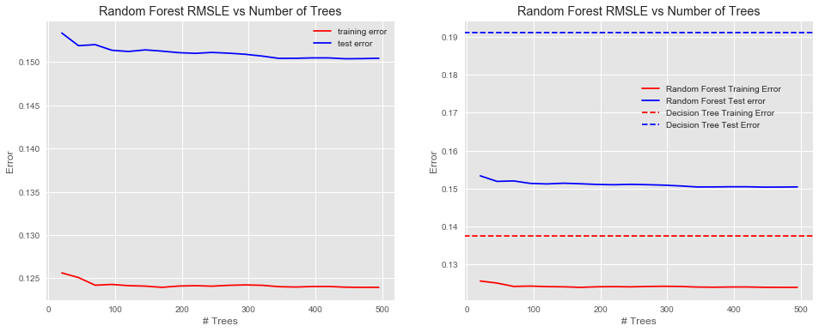
Random Forest

Slide 31
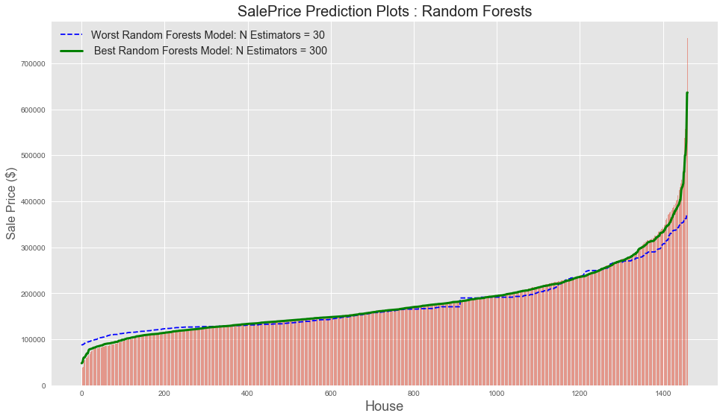
Random Forests

Slide 32
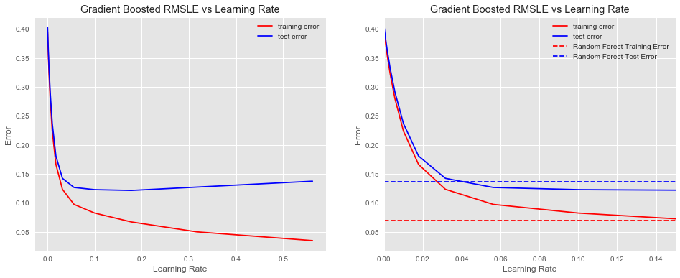
Gradient Boosting

Slide 33
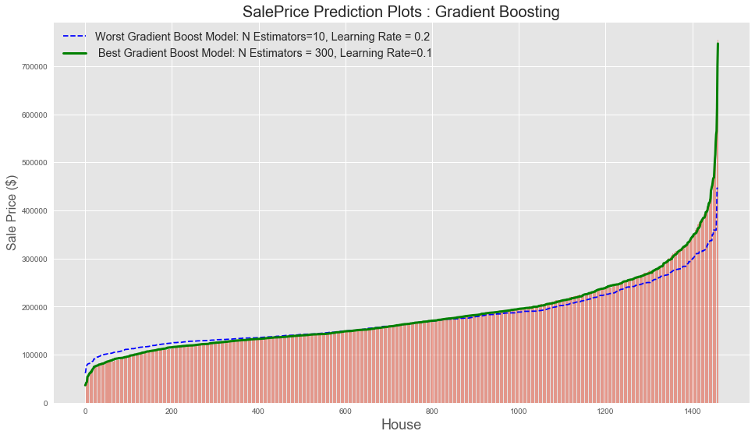
Gradient Boosting

Slide 34
CV Grid Search

